Slide 1

Domain Randomization and Its Use for Implicit 3D Orientation Learning from RGB Images
IVUL Group Meeting – October 9, 2018

Slide 2
Intro: Simulation to Reality Transfer

Slide 3
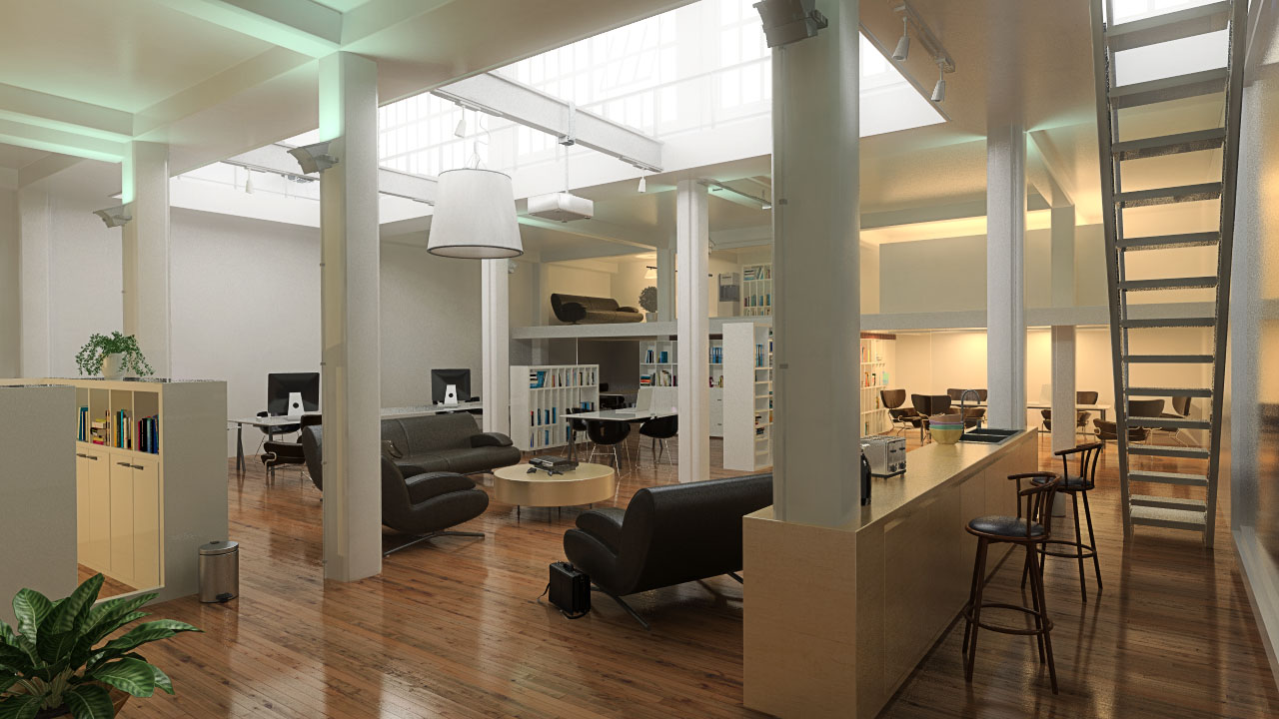
Intro: Simulation to Reality Transfer
Photo-Realistic Rendering

Slide 4
Intro: Simulation to Reality Transfer
Photo-Realistic Rendering
Downside:
Imperfect
Requires much effort

Slide 5
Intro: Simulation to Reality Transfer
Photo-Realistic Rendering
Domain Adaptation

Slide 6
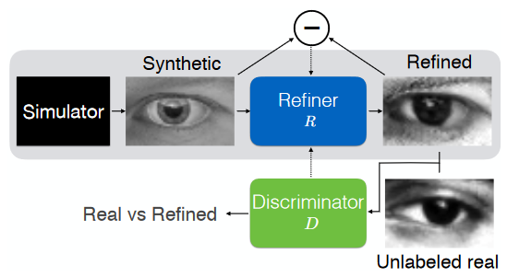
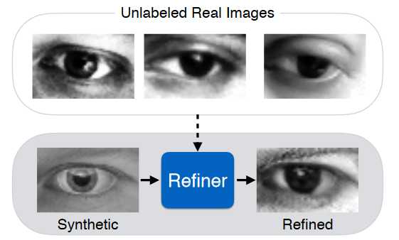
Intro: Simulation to Reality Transfer
Photo-Realistic Rendering
Domain Adaptation
Shrivastava, A., Pfister, T., Tuzel, O., Susskind, J., Wang, W., Webb, R.: Learning from Simulated and Unsupervised Images through Adversarial Training. (CVPR 2017)

Slide 7
Simulation to Reality Transfer
Photo-Realistic Rendering
Domain Adaptation
Domain Randomization

Slide 8
Simulation to Reality Transfer
Photo-Realistic Rendering
Domain Adaptation
Domain Randomization
Hypothesis: Training a model on rendered views in a variety of semi-realistic settings (augmented with random lighting conditions, backgrounds, saturation, etc.) will also generalize to real images.

Slide 9
What’s Domain Randomization?
Tobin, Josh, et al. "Domain randomization for transferring deep neural networks from simulation to the real world." Intelligent Robots and Systems (IROS), 2017
How to benefit from Domain Randomization?
Sundermeyer, Martin, et al. "Implicit 3D Orientation Learning for 6D Object Detection from RGB Images." Proceedings of the European Conference on Computer Vision (ECCV). 2018.

Slide 10
What’s Domain Randomization?
Tobin, Josh, et al. "Domain randomization for transferring deep neural networks from simulation to the real world." Intelligent Robots and Systems (IROS), 2017
How to benefit from Domain Randomization?
Sundermeyer, Martin, et al. "Implicit 3D Orientation Learning for 6D Object Detection from RGB Images." Proceedings of the European Conference on Computer Vision (ECCV). 2018.

Slide 11
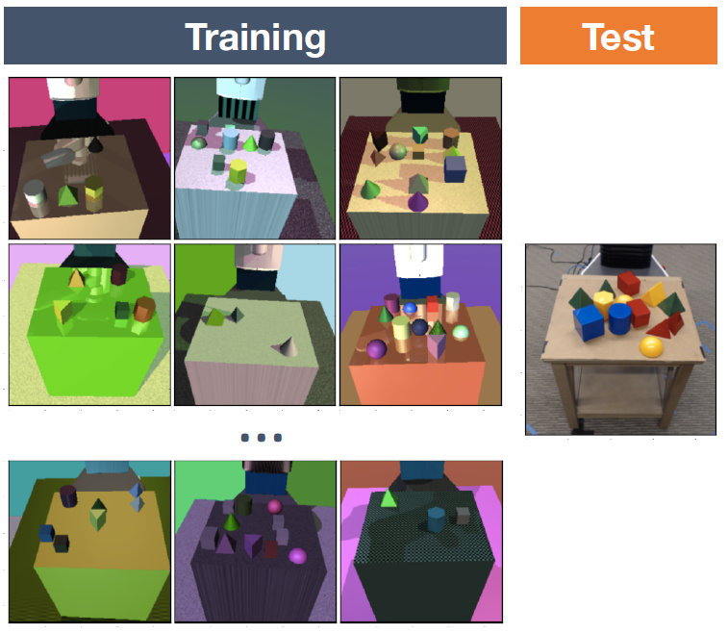
Domain Randomization
Bridge the ‘reality gap’ that separates simulated robotics from experiments
Train a real-world object detector that is accurate and robust to distractors and partial occlusions using only data from a simulator with non-realistic random textures

Slide 12
Domain Randomization
Number and shape of distractor objects on the table
Position and texture of all objects on the table
Textures of the table, floor, skybox, and robot
Position, orientation, and field of view of the camera
Number of lights in the scene
Position, orientation, and specular characteristics of the lights
Type and amount of random noise added to images

Slide 13
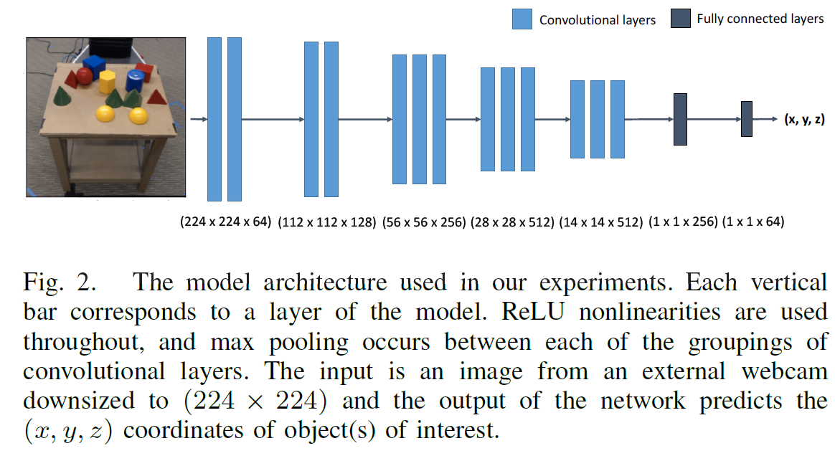
Experiments

Slide 14
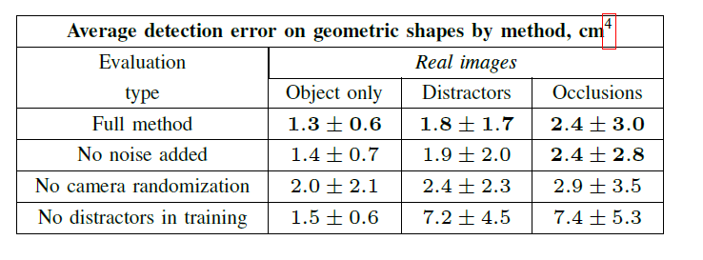
Results
20,000 training examples

Slide 15
What’s Domain Randomization?
Tobin, Josh, et al. "Domain randomization for transferring deep neural networks from simulation to the real world." Intelligent Robots and Systems (IROS), 2017
How to benefit from Domain Randomization?
Sundermeyer, Martin, et al. "Implicit 3D Orientation Learning for 6D Object Detection from RGB Images." Proceedings of the European Conference on Computer Vision (ECCV). 2018.

Slide 16
Implicit 3D Orientation Learning for 6D Object Detection from RGB Images
Why 6D from RGB?
2D object detection is not enough for some applications
Knowing the 3D orientation facilitates the scene understanding
Using RGB images to imply 3D orientation reduces the dependency on 3D sensors. When available, 3D sensors would still be effective for refinement (ICP)

Slide 17
Learning representations of 3D orientations

Slide 18
Learning representations of 3D orientations
Regression

Slide 19
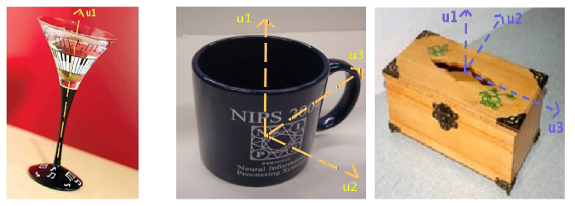
Learning representations of 3D orientations
Regression:
Regress a fixed SO(3) parameterizations like quaternions.
Difficulty: representational constraints and pose ambiguities can introduce convergence issues

Slide 20
Learning representations of 3D orientations
Regression
Classification

Slide 21
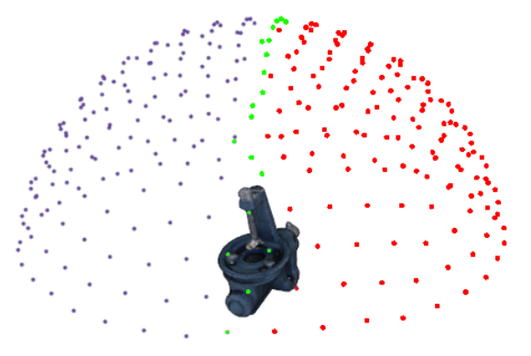
Learning representations of 3D orientations
Regression
Classification: discretization of SO(3)
Difficulty:
coarse intervals of ∼ 5º lead to over 50,000 possible classes.

Slide 22
Learning representations of 3D orientations
Regression
Classification
Symmetries

Slide 23
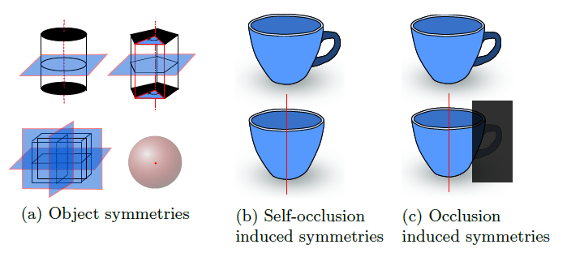
Learning representations of 3D orientations
Regression
Classification
Symmetries:
ignore one axis of rotation
train an extra CNN to predict symmetries

Slide 24
Learning representations of 3D orientations
Regression
Classification
Symmetries
Descriptor Learning

Slide 25
Learning representations of 3D orientations
Regression
Classification
Symmetries
Descriptor Learning:
learn a representation that relates object views in a low-dimensional space

Slide 26
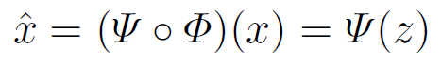
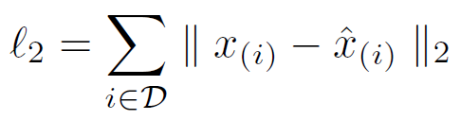
Method: Augmented Autoencoder (AAE)
Autoencoder
dimensionality reduction technique for high dimensional data
consists of an Encoder Φ and a Decoder Ψ, both arbitrary learnable function approximators (usually neural networks)
The training objective is to reconstruct the input x ∈ RD , after passing through a low-dimensional bottleneck (latent representation) z ∈ Rn with n << D :
Per sample loss:

Slide 27
Method: Augmented Autoencoder (AAE)
Denoising Autoencoders
Artificial random noise is applied to the input images x ∈ R_{D} while the reconstruction target stays clean
Hypothesis 1:
The Denoising AE produces latent representations which are invariant to noise because it facilitates the reconstruction of de-noised images.

Slide 28
Method: Augmented Autoencoder (AAE)
Augmented Autoencoder
apply random augmentations faugm(.) to the input images x ∈ RD against which the encoding shall become invariant
Does Hypothesis 1 hold for geometric transformations? Up next …

Slide 29
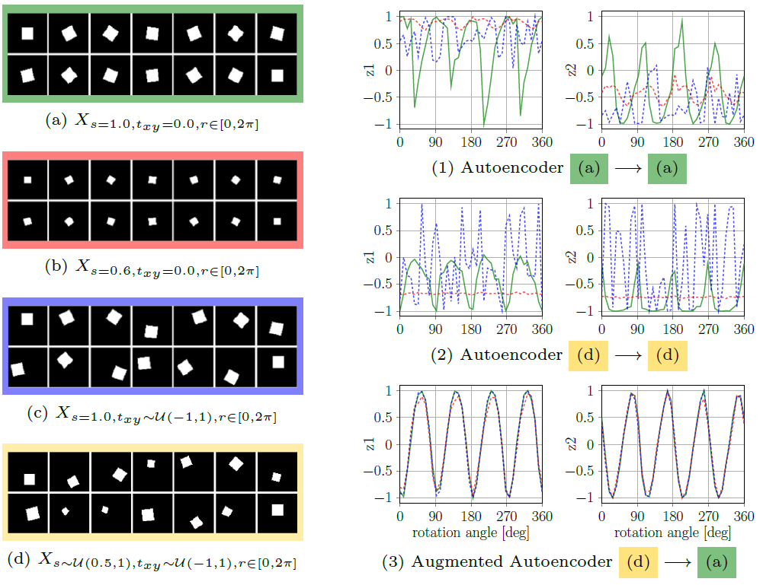

Slide 30
Learning 3D Orientation from Synthetic Object Views
Encode the whole SO(3) space of views from a 3D object model (CAD or 3D reconstruction) while being robust against inaccurate object detections
Inability to relate image crops from real RGB sensors because:
the 3D model and the real object differ
simulated and real lighting conditions differ
the network can’t distinguish the object from background clutter and foreground occlusions.

Slide 31
Learning 3D Orientation from Synthetic Object Views
Encode the whole SO(3) space of views from a 3D object model (CAD or 3D reconstruction) while being robust against inaccurate object detections
Inability to relate image crops from real RGB sensors because:
the 3D model and the real object differ
simulated and real lighting conditions differ
the network can’t distinguish the object from background clutter and foreground occlusions.
→ Domain Randomization

Slide 32
Learning 3D Orientation from Synthetic Object Views
Domain Randomization
rendering with random light positions and randomized diffuse and specular reflection
inserting random background images from the Pascal VOC dataset
varying image contrast, brightness, Gaussian blur and color distortions
applying occlusions using random object masks or black squares.

Slide 33
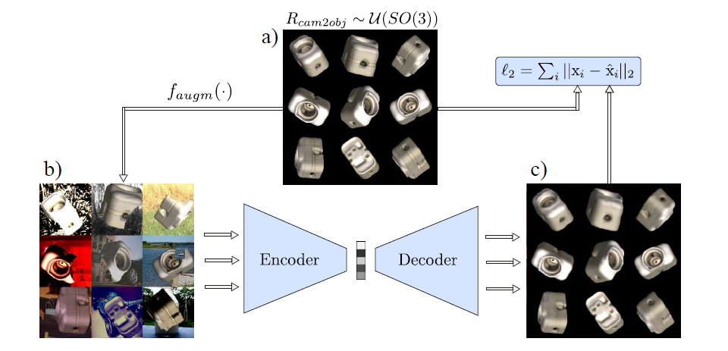
Learning 3D Orientation from Synthetic Object Views
Domain Randomization

Slide 34
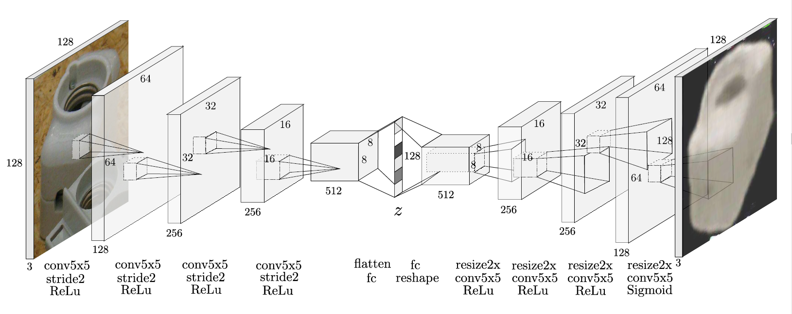
Network Architecture and Training Details

Slide 35
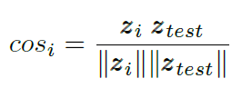
Codebook Creation and Test Procedure
Render clean, synthetic object views at equidistant viewpoints from a full view-sphere
Rotate each view in-plane at fixed intervals to cover the whole SO(3)
Create a codebook by generating latent codes z ∈ R¹²⁸ for all resulting images and assigning their corresponding rotation R_{cam2obj} ∈ R^{3x3}
At test time: area is cropped & resized to match the encoder input size.

Slide 36
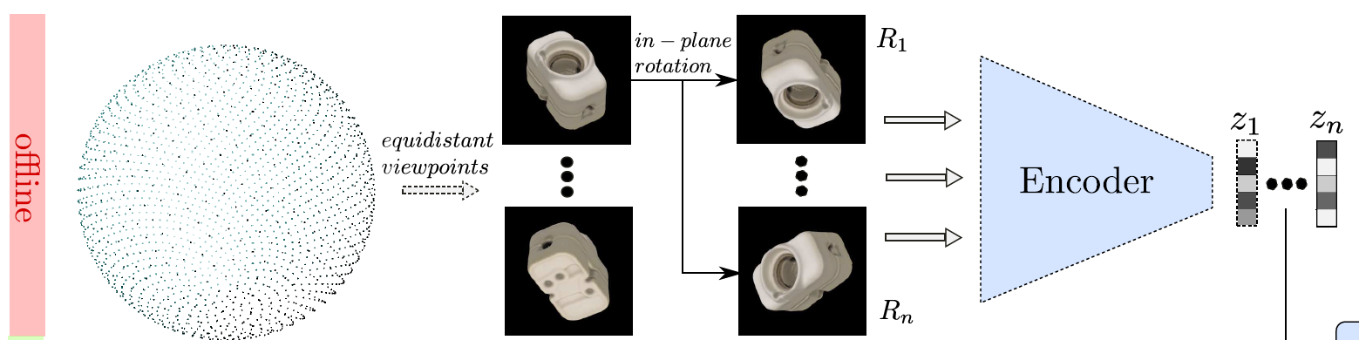
Codebook Creation and Test Procedure

Slide 37
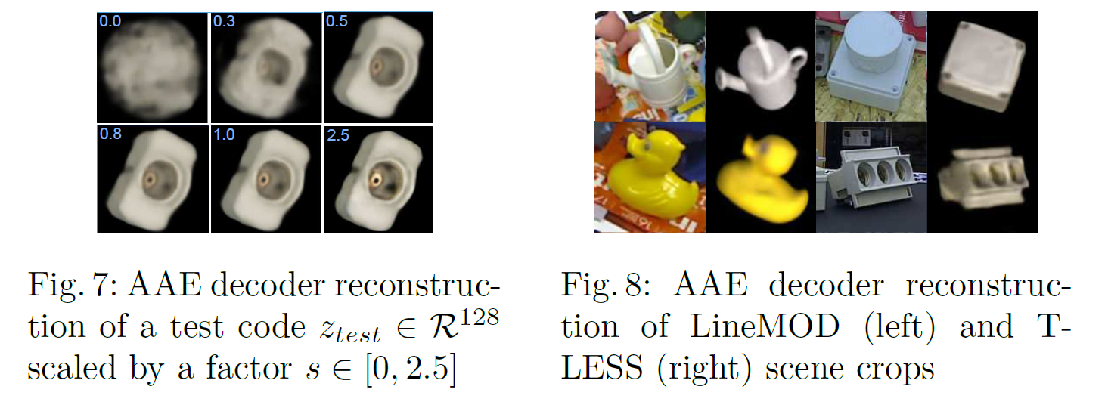
Codebook Creation and Test Procedure
Observation:

Slide 38
Extending to 6D Object Detection
Train an Object Detector:
Finetune SSD with VGG16 base using object recordings on black background from different viewpoints which are provided in the training datasets of LineMOD and T-LESS.
Multiple objects are copied in a scene at random orientation, scale and translation. Bounding box annotations are adapted accordingly.
60000 scenes with various color and geometric augmentations.

Slide 39
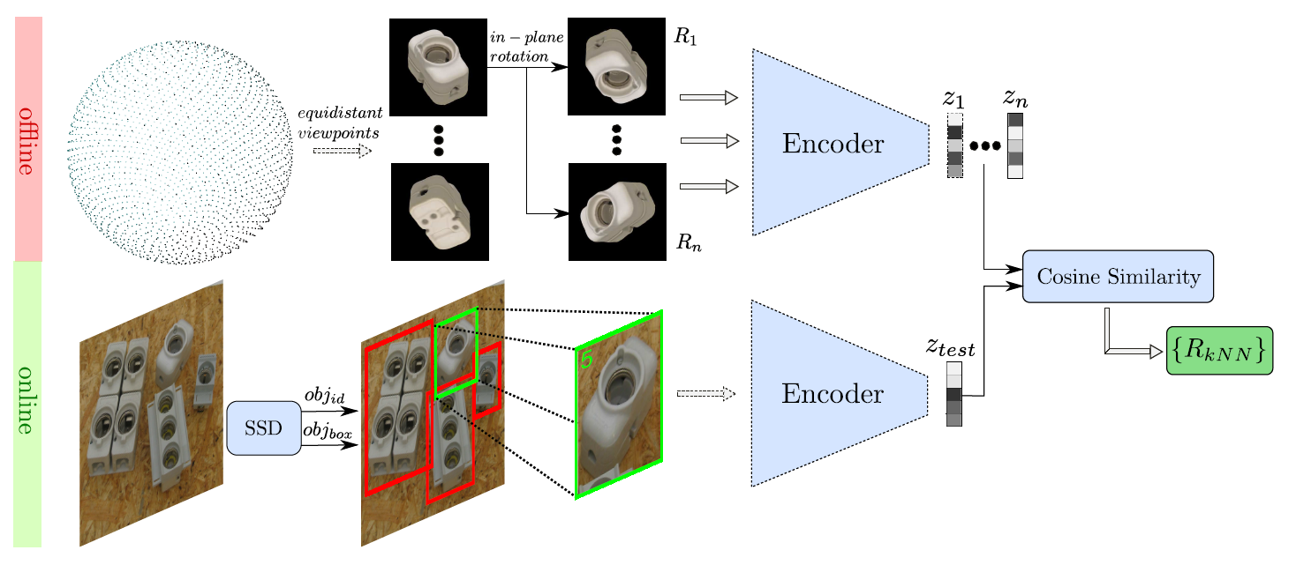
Extending to 6D Object Detection
Train an Object Detector:

Slide 40
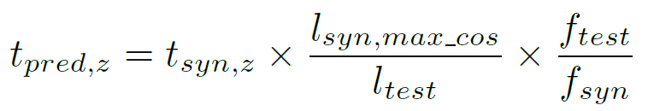
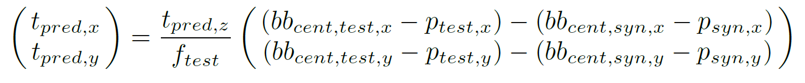
Extending to 6D Object Detection
Projective Distance Estimation

Slide 41
Extending to 6D Object Detection
ICP Refinement (Optional)
Standard ICP approach
∼ 200ms on CPU.

Slide 42
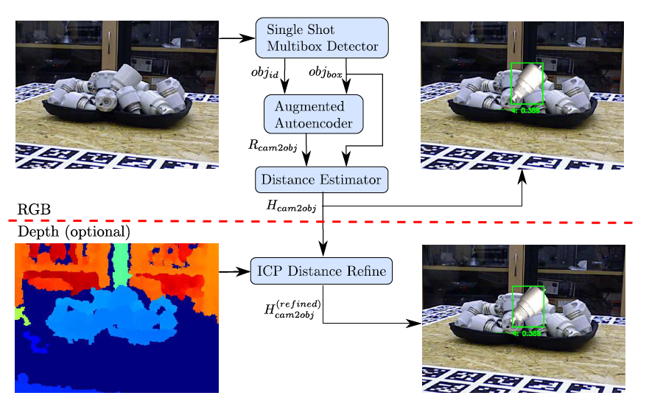
Extending to 6D Object Detection

Slide 43
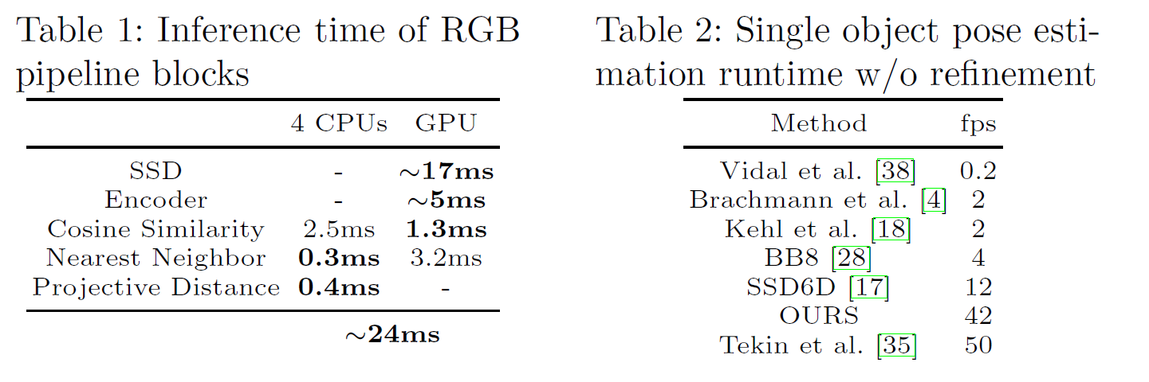
Runtime

Slide 44
Experiments
Metrics
Visible Surface Discrepancy (errvsd): distance between the estimated and ground truth visible object depth surfaces
Recall: correct 6D object poses at errvsd < 0.3 with tolerance τ = 20mm and >10% object visibility
ADD: Average Distance of Model Points
AUCvsd: the area under the ’errvsd vs. recall’ curve

Slide 45
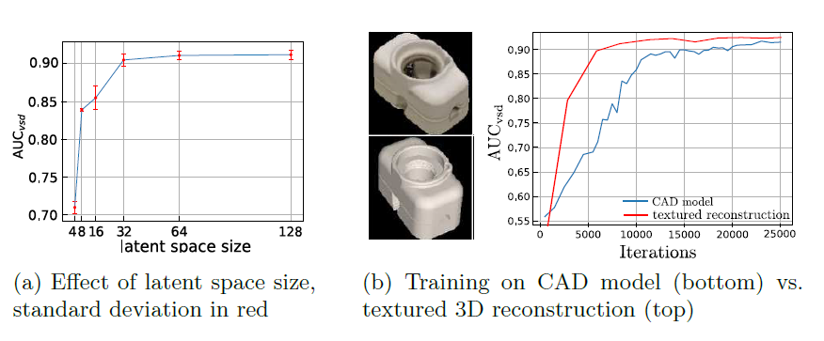
Experiments
Ablation

Slide 46
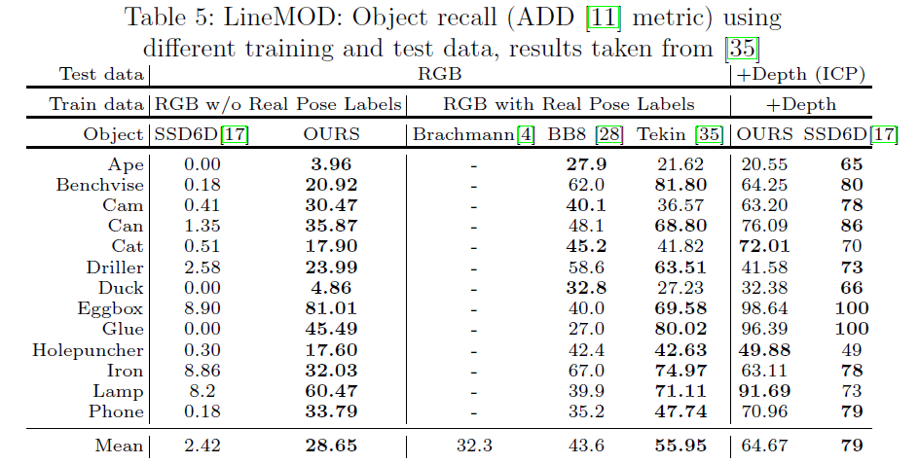
Experiments

Slide 47
Summary
Domain randomization helps bridging the gap between synthetic data training and real data testing
Augmented Autoencoders are effective once trained to perform specific tasks
6D object detection can be implied from RGB only (with the right training data)

Slide 48
Thank you

